Slide 1

Management science and financial accounting
UNIT-II
INTRODUCTION TO ORGANIZATIONAL BEHAVIOUR
Notes:
Dr.R.Umamaheshwar Rao

Slide 2
CONTENTS
Definition
Nature and scope of OB
Personality – Determinants
Perception
Attitude
Atrribution Theory
Johari Window
Transactional Analysis
Stress Management – factors and remedies

Slide 3
DEFINITION:
  OB is the understanding, prediction and management of human behavior in organizations.
  It refers to the behavior of individuals and groups within the organizations with focus on the interaction between organizational members and their external environments.

Slide 4
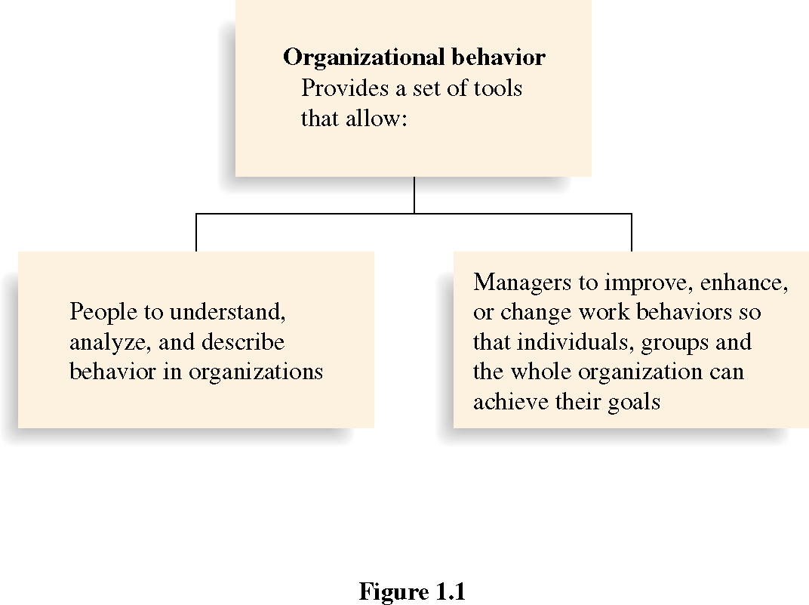
Why Organizational Behavior?

Slide 5

NATURE OF OB
OB is a distinct field of study
It is Interdisciplinary
An applied science
It is normative in nature
It is humanistic
It follows a total system approach

Slide 6
SCOPE OF OB
Impact of personality on performance
Employee motivation
Leadership
Creating effective teams and groups
Study of different organizational structures
Individual behavior, attitude and learning

Slide 7

PERSONALITY
Personality refers to a distinctive assemblage of traits—characteristic patterns of thinking, feeling, and behaving.

Slide 8
PERSONALITY
Only Physical appearance does not constitute personality.
Although personality can change over the course of time, one's core characteristics tend to remain steady over a lifetime.

Slide 9
DETERMINANTS OF PERSONALITY
Biological factors
Family and social factors
Cultural factors
Situational factors

Slide 10
PERCEPTION
  It is the process by which people select, organize, interpret, retrieve, and respond to information.
  It is the procedure by which we try to understand and interpret information about the environment that surrounds us.

Slide 11
  Perceptual information is gathered from:
    Sight.
    Hearing.
    Touch.
    Taste.
    Smell.

Slide 12

  Perception – Example:

Slide 13

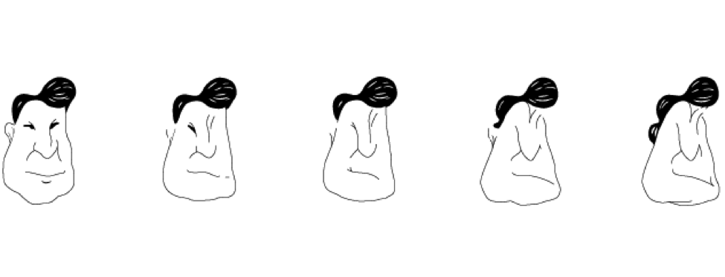
THE PERCEPTION PROCESS IMAGES

Slide 14
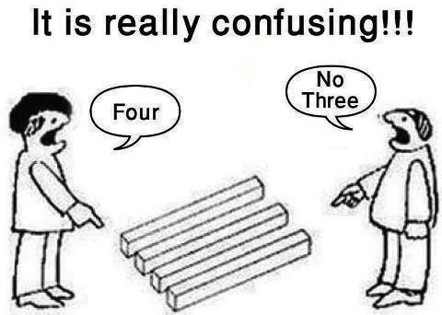
PERCEPTUAL SELECTIVITY
  It is the process by which individuals screen and select the various objects and stimuli that grab their attention.

Slide 15

ATTITUDE
  Attitudes can be defined as providing a state of readiness or tendency to respond in a particular way.

Slide 16
ATTITUDE
Our attitude determines how we look at a setback.
To a positive thinker, it can be a stepping-stone to success.
To a negative thinker, it can be a stumbling block.

Slide 17
IMPORTANCE OF ATTITUDE TO ORGANIZATION
Better team players
More loyal
Increase productivity and profits
Cut back on waste
Solves problem
Improve quality
Reduces stress
Good relationship with co-workers

Slide 18
ATTRIBUTION THEORY
Attribution refers to the process of explaining one’s own behavior and the behavior of others
Attribution theory describes how people describes events and experiences in their lives and how they adapt to the results of those actions.

Slide 19
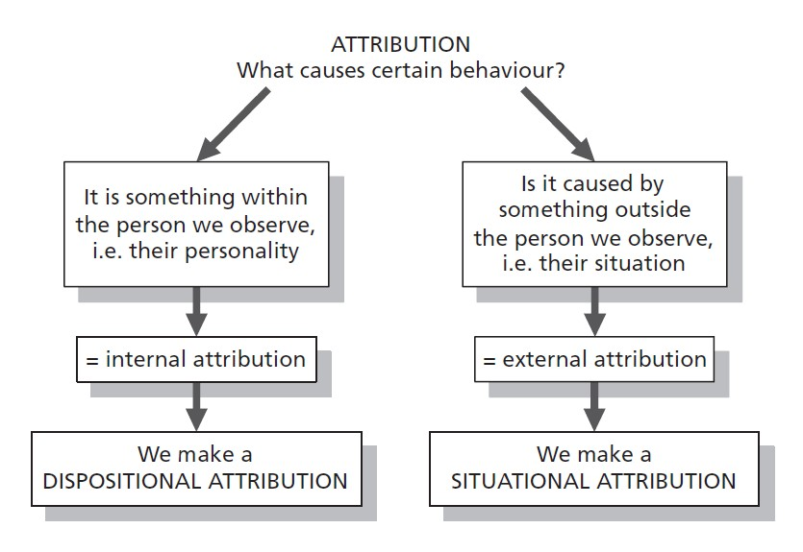
ATTRIBUTION THEORY

Slide 20
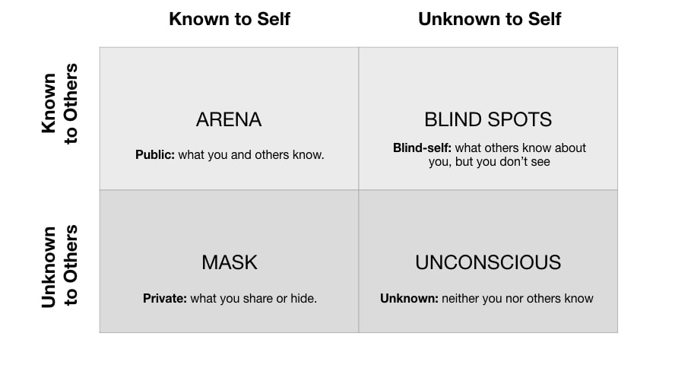
JOHARI WINDOW

Slide 21
JOHARI WINDOW
It is developed by American psychologists Joseph Luft & Harry Ingham in 1955.
This window helps an individual to know his values & beliefs and to understand himself in better way.

Slide 22
TRANSACTIONAL ANALYSIS
“When two people interact, there is a social transaction in which one person responds to another. The study of such transactions between people is called transactional analysis”.
“It is the study of social transaction between people.
It is technique used to help people better to understand their own & others behavior”.

Slide 23
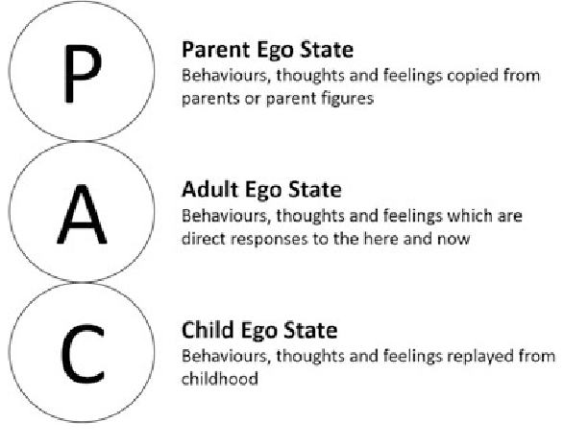
TRANSACTIONAL ANALYSIS - EGO STATES

Slide 24
ERIC BERNE AND TRANSACTIONAL ANALYSIS
Transactional analysis provides better understanding of how people relate to each other.
It helps in establishing better communication & improved human relationship.
It is a useful tool for helping people to understand & improve their interaction in their professional as well as personal lives.
Individual can decide on how to develop a transaction.

Slide 25

STRESS MANAGEMENT
Stress is simply the interaction of the individual with the environment - Ivancevich and Matteson

Slide 26
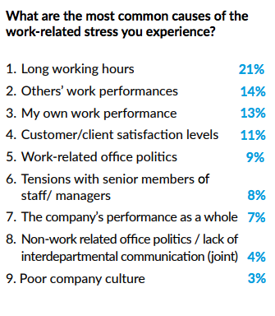
Outcomes of 2018 UK Work Place Stress Survey

Slide 27
Causes of Stress
The factors contributing to stress are called stressors.
External Stressors | Internal Stressors
Physical Environment | Lifestyle choices
Social Interaction | Negative self – talk
Organizational | Mind traps
Major Life Events | Personality traits
Daily Hassles

Slide 28
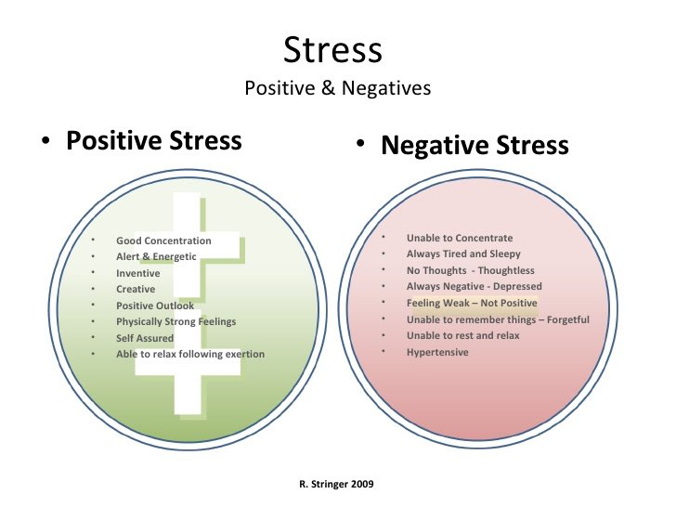
Types of Stress

Slide 29

REMEDIES

Slide 30
END

